Slide 1


Online safety
A guide for parents

Slide 2
Aims
Be aware of some of the issues involved in online safety.
Know how we can support our children.

Slide 3
Why take it seriously?
Cyberbullying
Grooming
Inappropriate material
Overuse/addiction
Viruses/hacking
Online reputation
Losing control over pictures/video

Slide 4
What do we know about our children?
In class and playground conversations we have…
I’m always on the net
I facetime who I want in my room
If my parents want a movie, I can get it.
I can download apps on my phone and ipad
I have facebook
I just lied about my age
I just type it into google and get it…free!
My mum doesn’t know how much I go on the internet
I use *website* and chat to people
See you on Instagram!
My x-box accesses the net

Slide 5
What children do online and through social networking
Children and young people go online to connect with friends and make new ones, to browse the internet for information, chat with others and play games.
They may:
- search for information or content on search engines like Google and Bing.
        - share images and watch videos through websites or mobile apps like Instagram, Pinterest, Vine and YouTube.

Slide 6
Use social networking websites like Facebook and Twitter write or reply to messages on forums and message boards.
Play games alone or with others through websites, apps or game consoles.
Chat with other people through online games, BBM (Blackberry Messenger), game consoles, webcams, social networks and tools like Whatsapp.
When online, children and young people can learn new things, get help with homework, express themselves creatively and connect with friends and family.
There are also risks, but by understanding and talking about the dangers you can help keep your child safe online.

Slide 7
Key stage 1
Pupils should be taught to:
Use technology safely and respectfully, keeping personal information private; know where to go for help and support when they have concerns about material on the internet.
Key stage 2
Pupils should be taught to:
Use technology safely, respectfully and responsibly; know a range of ways to report concerns and inappropriate behaviour.
Notes:
Why the resource is important-Ofsted expectations

Slide 8
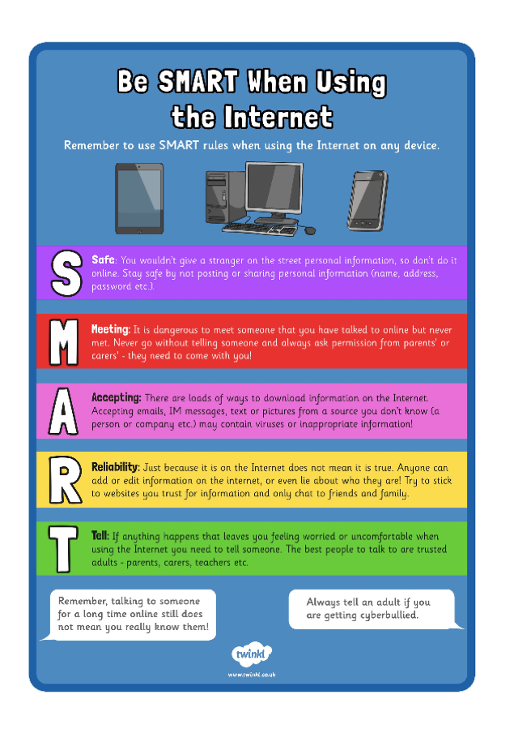
What we teach…

Slide 9

The internet is amazing when used safely and correctly.
Here are some simple rules that will help you make sure it stays amazing so that it plays a healthy part of your life.

Slide 10




Social Networks
Do you use any of these?
Did you know that it is illegal to have a Facebook account if you are under 13?
If your parents set it up for you, then you are required to be under adult supervision when using it.
Photo courtesy of (Jon@th@nC@flickr.com and forche.6@flickr.com) - granted under creative commons licence – attribution

Slide 11
Social Networks
Never share your personal information with anyone online. This includes your name, address, phone number and any school information. Get your privacy settings right!
Remember that anyone can be anybody online. An internet friend that you may think you have known for ages is still a complete stranger in real life.
Use a nickname instead of your real name and put up an avatar of yourself on your profile rather than a real one.
Keep your passwords safe by changing it regularly. It will be much more difficult to guess if you do.

Slide 12
Blocking Wisely
Block and delete any emails from anyone you don’t know.
Do not open any attachments from people you don’t know as it could be a nasty virus!
If anyone sends you a nasty email or messages, just block them. Arguing will not help, and you do not have to put up with it!
This applies to all devices that use the internet e.g. DS, Xbox and iPads.

Slide 13



Cyber Bullying
Cyber bullying is no different to bullying in real life.
If someone says something that upsets you, you need to tell someone you trust about it, such as a teacher or parent and block the bully.
Remember that typing something nasty in a message to someone is just as upsetting as saying it to their face. Think before you send!

Slide 14
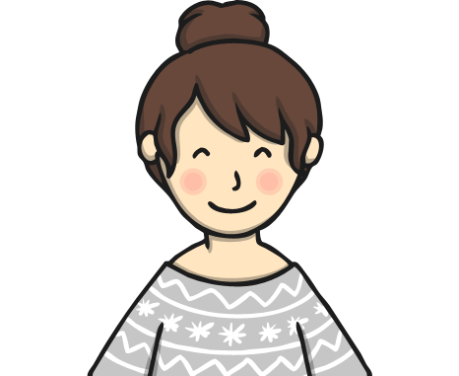

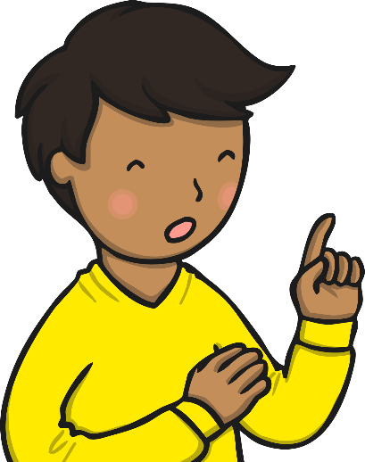
Meeting People Offline
Never meet anyone from the internet without an adult with you as this is very dangerous!
Talk to a trusted adult about it.

Slide 15
Gaming is a fun and sociable way to spend time, encouraging teamwork and developing skills.
All positive ideas, but there are a few things you need to be aware of:
Gaming
Notes:
CyberSense scenario to open discussion and raise awareness – watch Gaming cyber-story: ‘What harm can it do?’ – link https://cybersense.wistia.com/medias/faju9uq2zm

Slide 16
Gaming - What can you do?
Get involved by finding out what type of games your child enjoys and making sure they’re appropriate for their age.
Some games let children play and chat with anyone in the world. This means they might come across offensive language and bullying. Children should only game with people they know and not invite any strangers into their chatrooms.
Not everyone online is who they say they are. Children should avoid giving out personal details that could identify them or their location.
Some games encourage players to buy extra elements during the game – children have been known to run up large bills without realising.
In extreme cases bullying, also known as ‘griefing’, can be used as a tactic to win games. Children may find themselves either bullying or being bullied. Try and have the computer in a shared space so you can keep an eye on what is happening.
Is there a moderation feature or a report abuse button?

Slide 17
Jigsaw
https://www.youtube.com/watch?v=_o8auwnJtqE&safe=true

Slide 18
Images - What can you do?
Explain to young people they should never pressurise anyone/be pressured into sending/posting an image.
Be clear about what can happen if they do send an unpleasant/threatening/inappropriate image.
Where the image goes next and who sees it will not be under their control.
Make sure they are aware it is against the law to take or hold an inappropriate image of someone under the age of 18.
Notes:
Hints and tips for parents

Slide 19
What is cyberbullying?
Cyberbullying is the use of digital-communication tools (such as the Internet and cell phones) to make another person feel angry, sad, or scared, usually again and again.
Examples of cyberbullying include sending hurtful texts or instant messages, posting embarrassing photos or video on social media, and spreading mean rumours online or with mobile phones.
If you're trying to figure out whether your child is being cyberbullied, think about whether the offender is being hurtful intentionally and repeatedly. If the answer is no, the offender might simply need to learn better online behaviour. If the answer is yes, take it seriously.

Slide 20
How do I report cyberbullying?
Social media sites such as Facebook, Instagram, and Snapchat have become more serious about helping users who have been targeted by bullies. If your child is bullied on a website or in an app, go to the company's site and look for a section offering support, such as "Community Guidelines," "Safety Center," "Parent Info," "Safety Tips," or something similar.
If your child is bullied or harassed over text message, call your mobile phone provider to report the number. You may be able to block it or change your phone number. Many carriers offer additional anti-bullying features for a fee.
If the abuse continues, you may need to enlist the help of your community: your child's school, his or her coaches, or other parents. If the communication contains threats, you'll need to report it to law enforcement.

Slide 21
What can I tell my child to do if he or she is being cyberbullied?
Sign off the computer. Ignore the attacks and walk away from the cyberbully.
Don't respond or retaliate. If you're angry or hurt, you might say things you'll regret later. Cyberbullies often want to get a reaction out of you, so don't let them know their plans have worked.
Block the bully. If you get mean messages through IM or a social-networking site, take the person off your buddy or friends list. You also can delete messages from bullies without reading them.
Save and print out bullying messages. If the harassment continues, save the evidence. This could be important proof to show parents or teachers if the bullying doesn't stop.
Talk to a friend. When someone makes you feel bad, sometimes it can help to talk the situation over with a friend.
Tell a trusted adult. A trusted adult is someone you believe will listen and who has the skills, desire, and authority to help you. Telling an adult isn't telling -- it's standing up for yourself. And, even if the bullying occurs online, your school probably has rules against it.

Slide 22
What do parental controls do?
There are many types of controls available, and they allow you to do a number of different things, such as:
- filter and block content you don't want your children to see – such as violence and pornography
- restrict information that can be shared
- set time limits on how long children are online
- control the time of day that children can access the internet
- set different profiles, so that each family member can access content that's appropriate to them.

Slide 23
SafeSearch is a feature of Google Search that acts as an automated filter of pornography and potentially offensive content. ...
On 11 November 2009 Google introduced SafeSearch Lock, which allows users with Google accounts to lock on the "High" mode of SafeSearch in Google's Web, image and video searches.

Slide 24
SafeSearch
https://www.youtube.com/watch?v=fHUVwF80Hgg&safe=true

Slide 25
6 easy steps to help keep your children safe online
Controls aren't a single solution to staying safe online. Talking to your children and encouraging responsible behaviour is critical. However, controls are a vital first step to helping to protect your child online.
1 Set up home broadband parental controls
These allow you to control what content is seen on any device connected to your broadband router, or hub.
2 Set controls on your search engine
  Encourage your child to use child-friendly search engines and activate and lock safe search settings.
3 Make sure every device is protected
Controls should be installed on every device your child uses – mobile phones, tablets and games consoles.

Slide 26
4 Privacy settings
Activate safety measures offered by different sites. Sites like Facebook have settings that help prevent your child seeing unsuitable advertising.
5 Block pop-ups
If you're worried about your children accessing inappropriate content through clicking on pop-ups, BBC Webwise has advice on how to stop these.
6 Keep talking
Parental Controls are a really useful part of your toolkit to keep your children safer online, and can be adjusted as your child grows, but it's vitally important to remember to talk regularly to your children about what they are doing online.
  You can find more tips on how to start these conversations at internetmatters.org.

Slide 27
Where to go for help!
National organisations that support young people to stay safe online.
CEOP- www.ceop.police.uk
Childnet - www.childnet.com
NSPCC - www.nspcc.org.uk
Childline - www.childline.org.uk
Think U Know - www.thinkuknow.org.uk
Ask About Games - www.askaboutgames.com
Internet Matters - www.internetmatters.org
Barnardo’s - www.barnardos.org.uk
Notes:
Tell someone! Research the websites and decide how you want to support your child

Slide 28
More links & guides for parents
https://www.thinkuknow.co.uk/parents/Primary/
https://www.thinkuknow.co.uk/Teachers/blog/Dates/2015/2/BRAND-NEW-CEOP-RESOURCE-The-Thinkuknow-Toolkit/
CEOP online guide https://www.thinkuknow.co.uk/parents/Primary/
UK government Advice on child internet safety 1.0’ http://media.education.gov.uk/assets/files/ukccis%20advice%20on%20child%20internet%20safety.pdf
Parent help to understand the internet http://www.bbc.co.uk/webwise/
CEOP website www.thinkuknow.co.uk
https://www.thinkuknow.co.uk/Teachers/Resources/
Recent special on Newsround:
http://www.bbc.co.uk/newsround/13908828
Staying safe videos and links http://www.bbc.co.uk/cbbc/articles/stay-safe-useful-links
BBC staying safe fun videos http://www.bbc.co.uk/cbbc/topics/stay-safe
CEOP children’s games website http://www.kidsmart.org.uk/
http://www.bbc.co.uk/newsround/31356817
http://www.kidsmart.org.uk/teachers/
http://www.kidsmart.org.uk/downloads/cn_A2posterPRIMARY.pdf

